Slide 1

Cotuit Water Department Long Term Plan
Board of Water Commissioners
Prudential Committee Long Term Planning Meeting
September 21, 2026

Slide 2
Long Term Plan
Purpose:
Advise the taxpayers of the Cotuit Fire District of potential water department capital projects and expenses which will affect the district tax rate
Estimate the cost of those projects
Estimate the timing for those projects

Slide 3
2025 Statistics
Winter Population: 3292
Summer Population: 4936
Accounts: 2330
2025 pumpage: 171,337,000 gallons
Gallons-per-day avg. 470,000 gallons
Peak day: (07/30/2024) 1,407,000 gallons
Water Mains: 53 miles
Wells (Stations) 5
Tanks: (2) 800,000 gallon capacity
Hydrants: 444

Slide 4
Three factors for future capital projects:
Water Treatment
Infrastructure
Supply & Demand

Slide 5
Water Treatment

Slide 6
Water Treatment Costs
In 2019 the Board of Water Commissioners anticipated the need for a water treatment plant in 2019 due to rising levels of iron and manganese
Tata & Howard was commissioned in 2019 to perform a Source Water Quality & Treatment Evaluation
  T&H estimated a cost between $10,250,000 and $11,245,000 to treat water at stations 1, 2, and 4
  The estimate did not treat stations 3 & 5
The proposed solutions treated only iron and manganese and not:
  PFAS
  Nitrates
  Sodium
To treat PFAS, the Straightway Water Treatment Plant in Hyannis has an estimated total cost of $30-$35 million
A treatment plant would require adding a Grade 4 Treatment Operator to the payroll @ $64,500-$80,000 ann.

Slide 7
Current Contaminant Levels
CONTAMINANT | COTUIT LEVEL | STATE BENCHMARK | STATUS | TREATMENT | PRIORITY ACTION
Manganese | 47.6 ppb avg 90 ppb peak | 300 ppb health advisory | Well below | Unnecessary | Continue monitoring
PFAS | 3.5 ppt | 20 ppt state limit | Well below | Not needed within 5 years. | Continue annual testing. If one result exceeds 10 ppt, then we must test monthly
Sodium | 17.49 ppm avg 23.21 ppm peak | 20 ppm advisory | Near advisory | Will not reduce levels | Work with local and state DPWs to reduce road salt
Iron | Low | 300 ppb aesthetic guideline | Low | Unnecessary | Continue to minimize use of Station 4 near Little River
Nitrates | 2.4 mg/L | 10 mg/L maximum | Well below | Will not reduce levels | Prioritize upstream sewer extension or I/A septic

Slide 8
Treatment outlook
The BOWC will request an updated estimate from Tata & Howard
Adding water treatment capabilities will reduce Mn, Fe, and PFAS
  It will not reduce sodium or nitrates
Source Water Protection (investing in “upstream” protection) would mitigate PFAS and Nitrate contaminant levels
No infrastructure improvements will reduce Sodium levels
Lobbying CWMP for sewer prioritization in zone of contribution
  Sewers will not reduce Mn & Fe
Reducing pumping demands on Station 4 near wetland sources of Mn and Fe
Exploring “cluster” wastewater treatment options in zone of contribution
The need for a water treatment facility is not anticipated within the next five years

Slide 9
Infrastructure

Slide 10
Existing Infrastructure
Cotuit has 53 miles of water mains (approx. 300,000 feet) connecting 2330 accounts.
The system began in 1936 and has sections that are 90 years old (cast iron)
Two recent water tanks have an expected service life of 75-100 years (2010 & 2017).
  They will need recoating/painting every 20 years at an approximate cost of $1.2 million each
In 2025 the Cotuit Water Department embarked on a semi-annual water main replacement plan budgeted at $500,000 in FY 2027 and FY 2029. Recommend adding an annual budget of $250K for water main replacement at the Superintendent’s discretion.
The cost of replacing water mains is estimated at $440.00 per foot with a 4% yearly increase (includes engineering and certain required specs).
The BOWC has asked the Superintendent to develop a system-wide inventory and map to support long-term planning for water main improvements and replacement. Priorities will be based on factors such as main age, condition, and water quality. Work along Route 28 is expected to be more costly due to state roadway requirements and permitting.
The BOWC will seek opportunities to replace water mains during other construction projects (e.g. sewer extension)

Slide 11
Additional Infrastructure Forecasts
Vehicle replacement (lime truck) FY 2028 @ $100,000 cost
Pump replacement every 6-12 years @ $60k-$80k per well
Generator replacement every 50 years @ $70k per well
SCADA system upgrades: $55,000 per year to 2030
  With further upgrades anticipated due to changing risks and technology

Slide 12
Supply and Demand

Slide 13
Supply
The state permit allows 230 million gallons per year (0.63 MGD) to be pumped by the CWD
  Permit capacity dependent on mitigation/open space preservation (e.g. Route 28 conservation restriction with BLT added capacity)
CWD is currently at 73% of its state permit capacity
The combined pumpage capacity of the 5 wells is 2800 gpm
  Theoretical daily pumping capacity is 4 million gpd

Slide 14
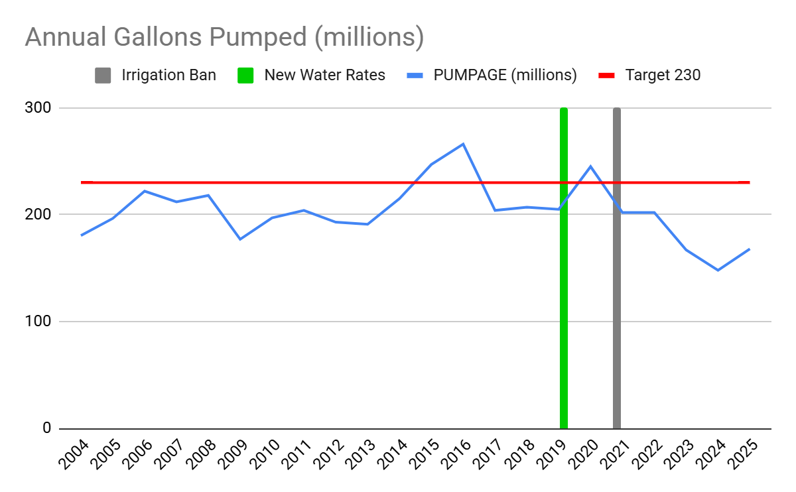

Slide 15
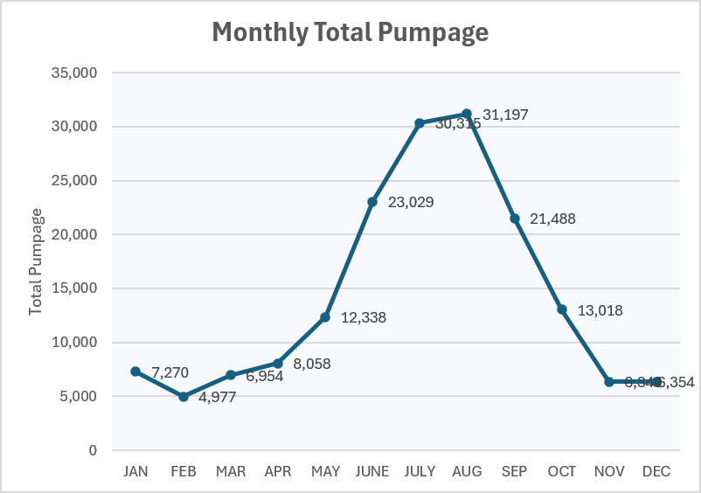
2025, 1000s of gallons

Slide 16
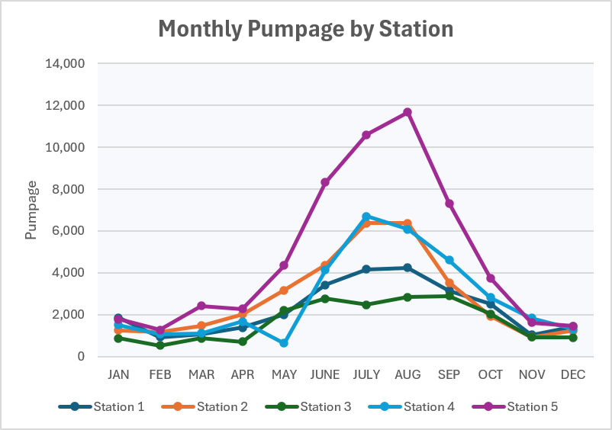
2025, thousands of gallons.

Slide 17
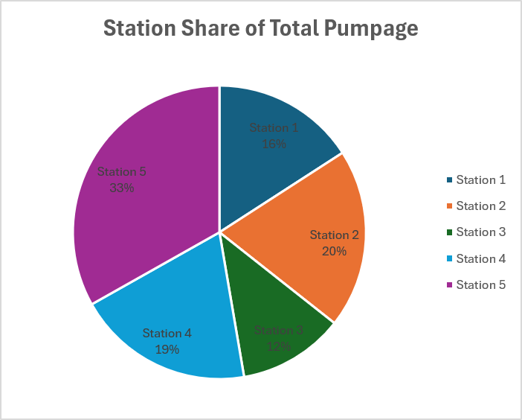
Station 5 (Rte. 28) furnishes 33% of the supply
Followed by:
  Station 2 (20%)
  Station 4 (19%)
  Station 1 (16%)
The three Sampson Mill Road stations account for 55% of the supply
Station 3 (behind the Coop) is run at low volumes to prevent saltwater intrusion

Slide 18
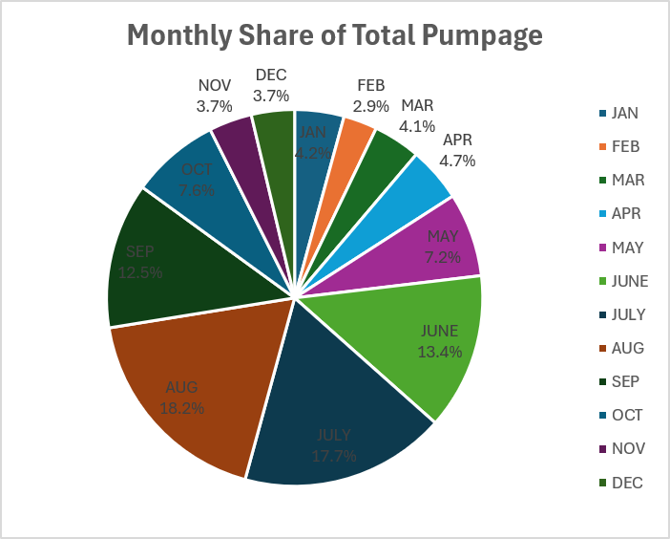
Peak Demand
August (18.2%) and July (17.7%) combined, accounts for 36% of annual demand

Slide 19
Demand
Average water use per single family home is 242 gpd
Peak summer demand is 1.4 million gpd.
The theoretical maximum daily pumpage capacity of the 5 wells is 4 million gallons*
2006 Stearns & Wheel Build-Out Assessment
  Assumed 2-acre zoning
  Estimated a potential for 635 new services
  233 have been added since 2004
  Approximately 400 could be added
  Did not assume impact of ADUs or multi-family development
Accounts have grown 233 from 2097 in 2004 to 2330 in 2025
*=all pumps running 24 hours at combined flow of 2800 gpm

Slide 20
Conservation Results
Significant Decline in Overall Water Usage: pumpage peaked in 2016 at 266 million gallons and another spiked again in 2020 at 245 million gallons. Since 202, usage has dropped dramatically, reaching a 20-year low of 148 million gallons in 2024 before a slight uptick in 2025.
Improved Efficiency (Gallons per Account): Even though the total number of accounts has steadily increased over the years (growing from 2,097 in 2004 to over 2,300 in recent years), the water used per account has decreased significantly. It dropped from a peak of 115,000 gallons per account in 2016 to just 62,000 in 2024.
Success in Meeting the 230M Target: After exceeding the 230 million gallon annual target in 2015, 2016, and 2020, the system has successfully stayed well below this threshold for the last five consecutive years (2021–2025).
Impact of Policy Interventions: There is a strong correlation between policy changes and reduced usage. Following the introduction of New Water Rates in 2019 and 2024 and the Irrigation Ban in 2021, both total pumpage and gallons-per-account saw notable downward trends, suggesting these measures were highly effective in curbing water demand.
However ….

Slide 21
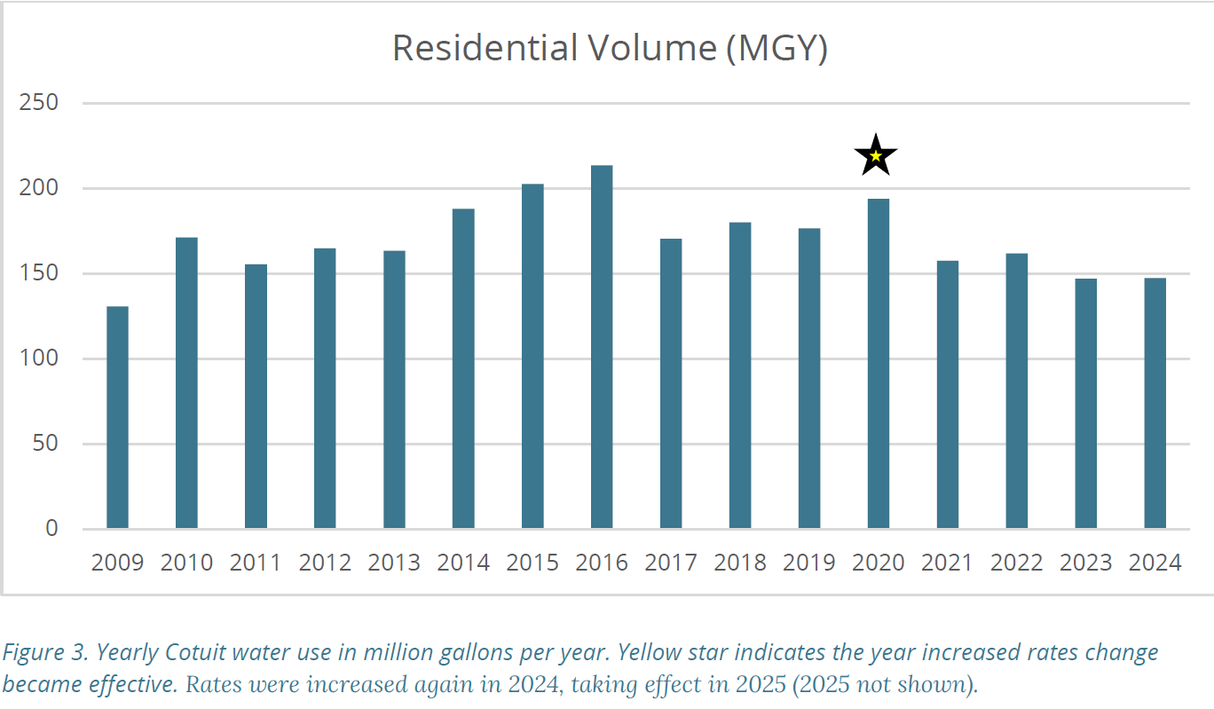
“Cotuit banned new private irrigation systems connected to the public water supply. Following the introduction of a tiered water rate system with higher rates for some consumers, the district saw a reduction in water consumption. Since 2020, CWD estimates it has reduced pumping volumes by approx. 20% -25%” –Cape Cod Commission “Water Rates and Use Analysis on Cape Cod, June 2025)

Slide 22
Growth Assumptions
If 400 new accounts are added, given the current efficiency of 72,000 GPA*, then capacity would climb from 73% to 85.6% of the state permit.
Based on the historical GPA average, 400 new accounts x 90670 gallons = ~35.3 million gallons and capacity would jump from 73% to 88.8% capacity.
The 2006 growth assessment did not account for accessory dwelling units.
Recommendation: the district should consider a revised capacity study.
*= Gallons Per Account

Slide 23
New Well Costs
Costs for a new public water supply well are estimated between $1.5 and $5 million for a well yielding 0.5 to 1.5 million gpd
Additional costs such as extensive land acquisition, long transmission mains, or advanced treatment can spike costs up to$5 to $10 million.
The BOWC has not to date identified land suitable for a sixth well but supply is very limited
Ideally, we would rely on four wells and consider the fifth a “contingency” well.

Slide 24
Water cost
YEAR | EXPENSE | Pumpage | Cost per 1000g | Inflation adj. | % Change
2004 | $404,196 | 180,512,000 | $2.24 | $3.81
2015 | $645,032 | 234,649,000 | $2.75 | $3.78 | -.79%
2024 | $801,366 | 154,212,000 | $5.19 | $5.50 | 45.4%

Slide 25
